Slide 1

SURVEY ON ADVERSARIAL ATTACKS AND DEFENSES on bert-based nlu tasks
TEAM 13
Abrar Ahmed Mohammed
Aishwarya Vijaykumar Sheelvant ​
Guantao Zhao
Manikandan Lapasi Parthasarathy ​
Manvitha Kalicheti
Sabeeha Syed​

Slide 2

Problem Statement/ Background
LLMs are everywhere!
Adversarial attacks are common ☹
Increases risk of using LLM!
We explored 5 attacks on 5 datasets with 3 base models and 2 defenses.
Goal: Deep dive analysis on each combination.

Slide 3
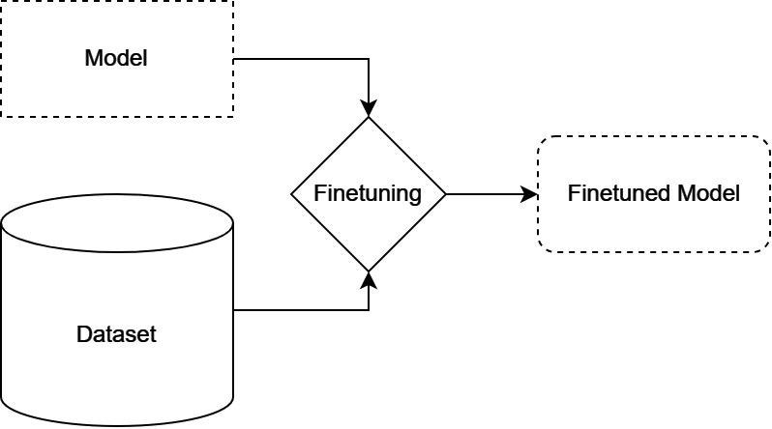
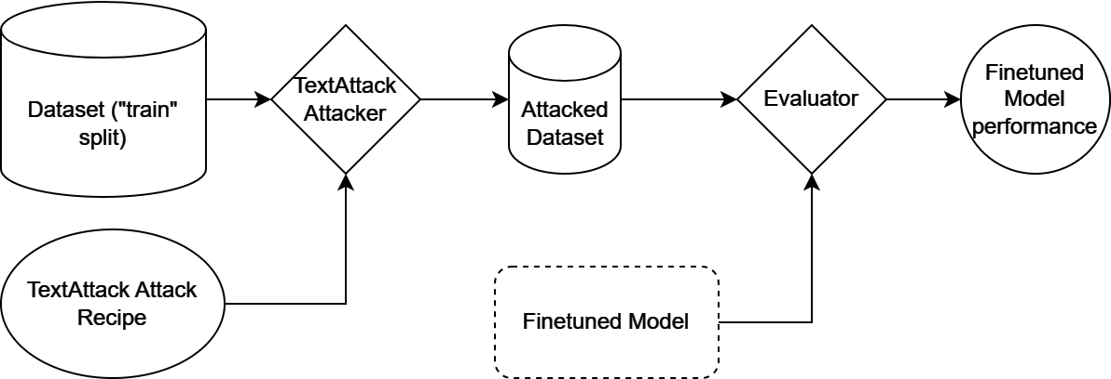
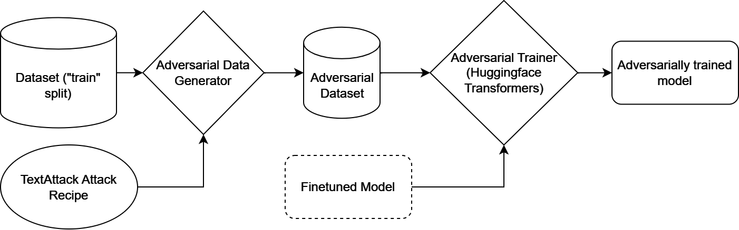
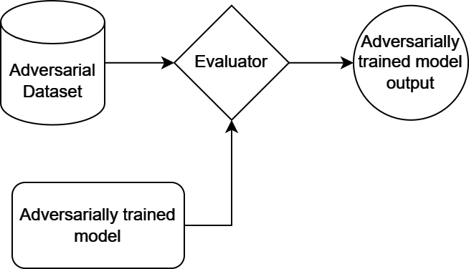
System architecture and data flow
Finetuning
Attack Evaluation
Adversarial Training
Adversarial model evaluation

Slide 4
Resources/Tools used
Programming Language: Python3
Computing: Google Colab Pro (Tesla T4 for training and inference)
Major Libraries and Frameworks:
PyTorch
HuggingFace datasets, transformers and model packages (Pretrained Deberta/Distilbert models, Trainers, Deberta/Distilbert Sequence Classification Heads, Deberta/Distilbert Tokenizers)
Textattack (attack recipes)
Optuna
Scikit-learn (Analysis)

Slide 5
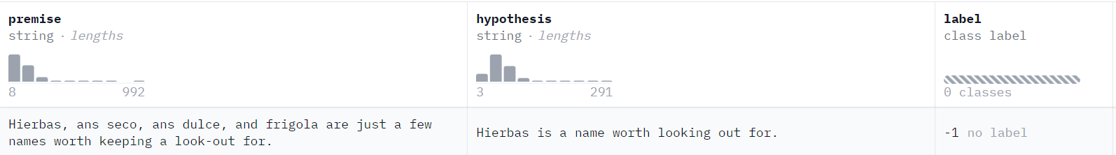
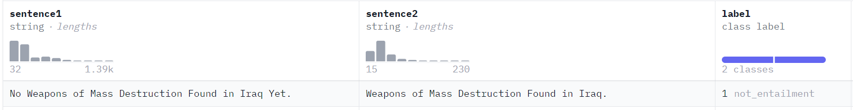
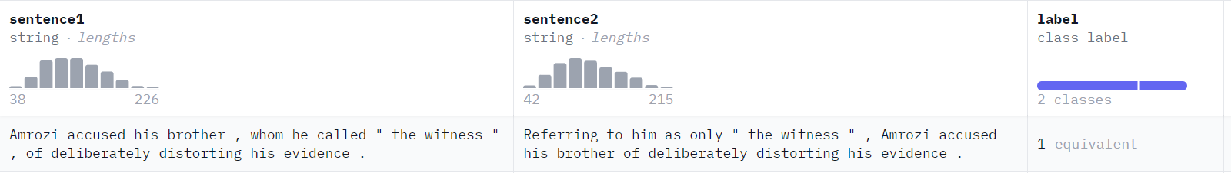
Datasets (GLUE)
MNLI - The Multi-Genre Natural Language Inference corpus is a crowd-sourced collection of 433k sentence pairs annotated with textual entailment information.
Train subset - 393k rows
Validation matched subset- 9.82k rows
Data - Premise, Hypothesis, label(0-entailment,1-neutral, 2- contradiction)
QNLI - The QNLI (Question-answering NLI) dataset is a Natural Language Inference dataset automatically derived from the Stanford Question Answering Dataset.
Train subset- 105k rows
Validation- 5.46k rows
Data- question-sentence pairs, label(0-entailment,1-not_entailment)
RTE Recognizing Textual Entailment (RTE). The datasets come from a series of annual textual entailment challenges.
Train subset- 2.49k rows
validation - 277 rows
Data - sentence1, sentence2, label(0-entailment,1-not_entailment)
MRPC - Microsoft Research Paraphrase Corpus (MRPC) is a corpus consists of 5,801 sentence pairs collected from newswire articles.
Train subset- 3.67k rows
Validation- 408rows
Data- sentence1, sentence2, label(0-entailment,1-not_entailment)
Notes:
Recognizing Textual Entailment (RTE). The datasets come from a series of annual textual entailment challenges.

Slide 6
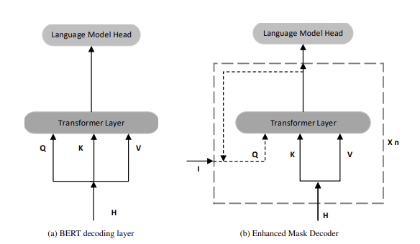
Model 1 – DeBERTAv3 xsmall
Decoding-enhanced BERT with disentangled attention that improves the BERT and RoBERTa models
Transformer-based language model; dynamically integrates word order information, enhancing contextual understanding using 2 Novel Ideas
It separates content and position information
Enhanced mask decoder
This disentanglement mitigates the impact of positional embeddings, reducing the risk of misinterpretation in complex language tasks.
This model uses Electra-style pretraining with Gradient Disentangled mechanism for an improved performance on NLU tasks. The DeBERTa V3 xsmall model comes with 12 layers and a hidden size of 384. It has only 22M backbone parameters with a vocabulary containing 128K tokens which introduces 48M parameters in the Embedding layer. This model was trained using the 160GB data as DeBERTa V2.
Comparison on attention patterns of the last layer between BERT and DeBERTa. In BERT, the absolute positions are passed to the input layer, but in DeBERTa, they are passed after the transformer layer and before the softmax layer to give additional context around position, disentangled from content
Image Source – Research Paper on DeBERTa : https://openreview.net/pdf?id=XPZIaotutsD
Notes:
we observe vertical strips in the attention patterns of RoBERTa, which are mainly caused by high-frequent functional words or tokens (e.g., “a”, “the”, and punctuation). For DeBERTa, the strip only appears in the first column, which represents the [CLS] token.

Slide 7
Hyperparameters – Debertav3 xsmall
Finetuned for 4 GLUE datasets.
Manually tuned – maintained default for all except epochs.
learning_rate = 2e-5
per_device_train_batch_size = 8
weight_decay = 0.01
Dataset/Size | num_train_epochs
RTE / 2.49k rows | 4
MRPC / 5.8k rows | 3
MNLI / 393k rows | 1
QNLI / 105k rows | 2

Slide 8
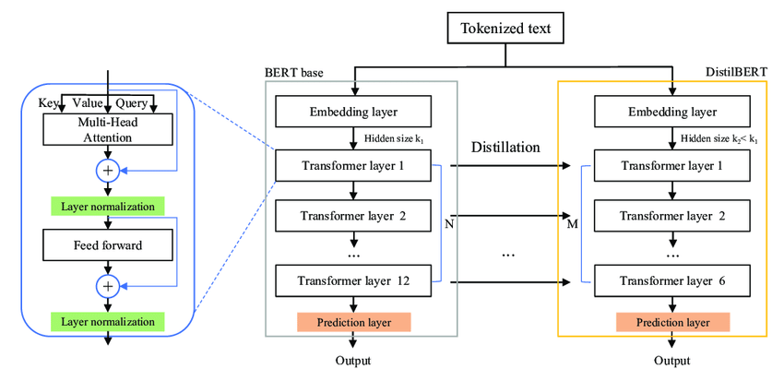
Model 2 – Distilbert BASE UNCASED
The Distilbert model leverages knowledge distillation during the pre-training phase and shows that it is possible to reduce the size of a BERT model by 40%, while retaining 97% of its language understanding capabilities and being 60% faster. So, the Distilbert has 67M parameters and the model is easier to train and evaluate.
DistilBERT model architecture
Image source: https://doi.org/10.3390/math10030447

Slide 9
HYPERPARAMETERS - Distilbert BASE UNCASED
Finetuned for 2 GLUE datasets.
Optuna – Python Framework for hyperparameter tuning
Default Search Algorithm - Tree-structured Parzen Estimator: a probabilistic model-based optimization algorithm. It models the objective function and samples new hyperparameter combinations based on the model. The basic idea behind TPE is to model the objective function as a probability distribution and then use this distribution to guide the search for optimal hyperparameters. TPE maintains two probabilistic models: one for the objective function values given the hyperparameters where the model assumes the best values are drawn from a Gaussian distribution, and another for the hyperparameters themselves.
DISTILBERT RTE
DISTILBERT MRPC
Learning_rate | 7.131e-05
num_train_epochs: | 4
per_device_train_batch_size: | 8
Learning_rate | 3.97e-05
num_train_epochs: | 3
per_device_train_batch_size: | 4

Slide 10
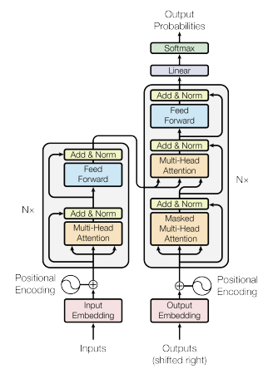
Model 3 - fiNE-TUNED-fINBert
Dataset: Auditor review sentiment collected by News Department
Label: positive, neutral or negative
Train : 3.88k
Test : 969 rows
Overview: Specialized in sentiment analysis for financial text and news headlines. The model parameters are the same as BERT. The model has 12 layers and has 110M parameters. The model thus achieves 97.4% accuracy on validation dataset.
Training Hyperparameters:
Learning Rate: 2e-05
Train Batch Size: 16
Eval Batch Size: 16
Random Seed: 42
Optimizer: AdamW-betas(0.9, 0.999)
Learning Rate Scheduler: Linear
Number of Epochs: 6
Number of Warmup Steps: 0.2 * Number of Training Steps
Transformer Architecture (from “Attention is all you need”, https://arxiv.org/pdf/1706.03762.pdf)

Slide 11
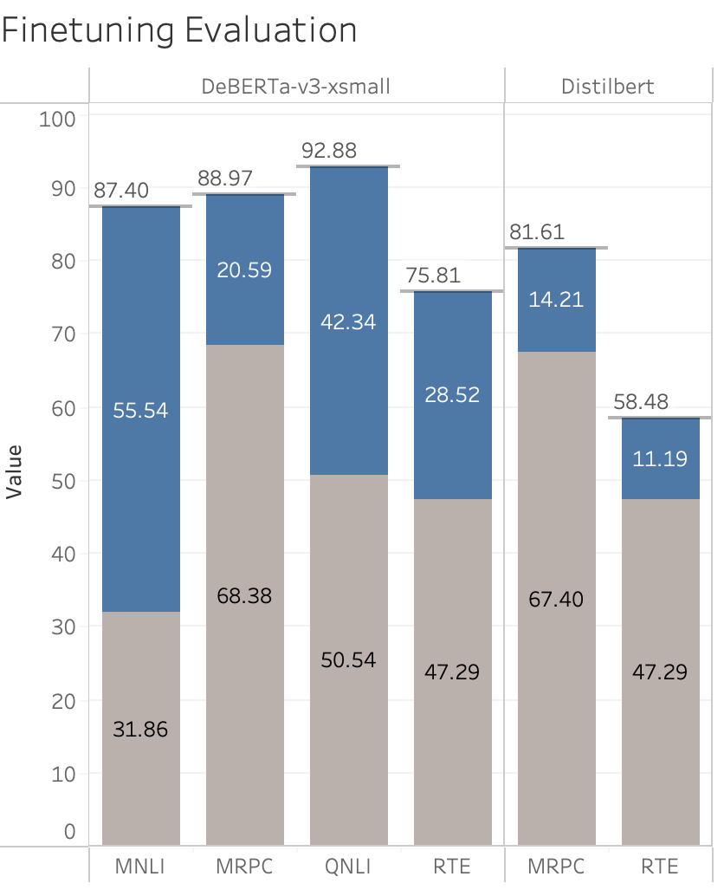
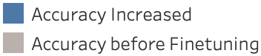
Finetuning results
For RTE, base accuracy for distilBERT and deBERTa is the same. But deBERTa seems to respond better to finetuning.
Overall, for both distilBERT and deBERTa, MRPC has the best base accuracy.
The most increase in accuracy after finetuning is for MNLI on deBERTa, while the least is for RTE on distilBERT.
DistilBERT is pretrained on 2 datasets: BookCorpus and English Wikipedia.
DeBERTa is trained on only half the data that was used to train RoBERTa. But RoBERTa was trained on 5 datasets: BookCorpus, English Wikipedia, CC-News, OpenWebText, Stories.
The increased variation of the types of data used for training in the case of DeBERTa could be a reason for its overall increased language understanding ability.

Slide 12
Attack 1 - TextBugger
The key idea behind TextBugger is to generate slight perturbations to the input text to mislead the NLP model into making incorrect predictions. The attack utilizes various word-level transformations to create adversarial examples. The five bug generation methods proposed in TextBugger are:
Insert: Inserting a space into the word.
Delete: Deleting a random character of the word except for the first and the last character.
Swap: Swap random two adjacent letters in the word except for the first and last letters.
Substitute-C (Sub-C): Replacing characters with visually similar characters (e.g., replacing “o” with “0”, “l” with “1”, “a” with “@”) or adjacent characters in the keyboard (e.g., replacing “m” with “n”).
Replacing a word with its top-k nearest neighbors in a context-aware word vector space (GloVe).
It uses several constraints for untargeted classification, such as universal sentence encoder.
It decides the perturbation priority of a word by analyzing the classification difference when that word is deleted
Example: Entailment => Not Entailment
Question: What happened to his lab? Sentence: His lab was torn down in 1904, and its contents were sold two years later to satisfy a debt. | Question: What came to his lab? Sentence: His lab was torn down in 1904, and its contents were sold two years later to satisfy a debt.
Paper: https://arxiv.org/abs/1812.05271
Source Code: https://textattack.readthedocs.io/en/latest/_modules/textattack/attack_recipes/textbugger_li_2018.html
Notes:
Description
Constraints
Transformations
Goal functions
Attack dabba across all models

Slide 13
Attack 2 - PWWS
Probability Weighted Word Saliency (PWWS), employs a greedy algorithm for text adversarial attack. The key innovation is a new way of selecting synonyms and deciding the order of their replacement in a sentence. Words are prioritized for a synonym-swap transformation based on a combination of their saliency score and maximum word-swap effectiveness. The algorithm essentially calculates the potential impact of each word's substitution on the classification probability and chooses the replacements that maximize this impact while maintaining the integrity of the original sentence.
Example: Not Entailment => Entailment
Question: The Tower District is centered around which historic theatre? Sentence: The theater was built in 1939 and is at Olive and Wishon Avenues in the heart of the Tower District. | Question: The pillar District is centered around which historic theatre? Sentence: The theater was built in 1939 and is at Olive and Wishon Avenues in the heart of the Tower District.
Paper: https://aclanthology.org/P19-1103.pdf
Source code: https://textattack.readthedocs.io/en/latest/_modules/textattack/attack_recipes/pwws_ren_2019.html#PWWSRen2019.build
Original source code: https://github.com/JHL-HUST/PWWS

Slide 14
Attack 3 - Deepwordbug
The essential idea behind deepwordbug attack is to swap characters from words. The attack picks the best from the following set of four transforms that swap, substitute, delete, and insert respectively
The algorithm also makes sure that a word is not modified twice, and that the transforms are not applied to stop words. It follows a greedy word swap approach with word importance ranking.
Example Not Entailment => Entailment
Question: In what year did Tesla's family move to Gospic? Sentence: Tesla was the fourth of five children | Question: In what yea did Tesla's family mov to Gospic? Sentence: Tesla was the fourth of fivK childreZn.
Paper: https://arxiv.org/abs/1801.04354
Source code: https://textattack.readthedocs.io/en/latest/apidoc/textattack.attack_recipes.html#textattack.attack_recipes.deepwordbug_gao_2018.DeepWordBugGao2018

Slide 15
ATTACK 4 - TEXTFOOler
The attack utilizes various word-level transformations to create adversarial examples. It swaps words that are in the same parts of speech with their top k closest embedding nearest-neighbors. In entailment tasks, it only edits the hypothesis and keeps the premise untouched.
It also uses a universal sentence encoder and prioritizes word perturbation based on deletion.
Example : Entailment => Not Entailment
Question: What are those from Jacksonville sometimes called? Sentence: People from Jacksonville may be called "Jacksonvillians" or "Jaxsons" (also spelled "Jaxons"). | Question: What are those from Ocala sometimes called Sentence: People from Jacksonville may be called "Jacksonvillians" or "Jaxsons" (also spelled "Jaxons").
Paper: https://arxiv.org/abs/1907.11932
Source code: https://textattack.readthedocs.io/en/latest/_modules/textattack/attack_recipes/textfooler_jin_2019.html#TextFoolerJin2019

Slide 16
Attack 5 - Improved Genetic Algorithm
The Improved Genetic Algorithm (IGA) is a search method for generating adversarial examples in natural language processing . It is an improvement over the original Genetic Algorithm (GA) in the following ways:
Faster: IGA uses a more efficient crossover operator that significantly reduces the number of iterations required to find an adversarial example.
More effective: IGA incorporates a novel pruning strategy that eliminates infeasible candidates early in the search process, further improving its efficiency.
More robust: IGA is less sensitive to hyperparameter choices than the original GA, making it more reliable and easier to use.
Example : Entailment => Not Entailment
Question: What percentage of farmland grows wheat? Sentence: More than 50% of this area is sown for wheat, 33% for barley and 7% for oats. | Question: What percentage of farmland grows wheat? Sentence More than 50% of this area is sown for ble, 33% for barley and 7% for oats.
Paper: https://arxiv.org/pdf/1909.06723.pdf
Source code: https://textattack.readthedocs.io/en/latest/_modules/textattack/attack_recipes/iga_wang_2019.html

Slide 17
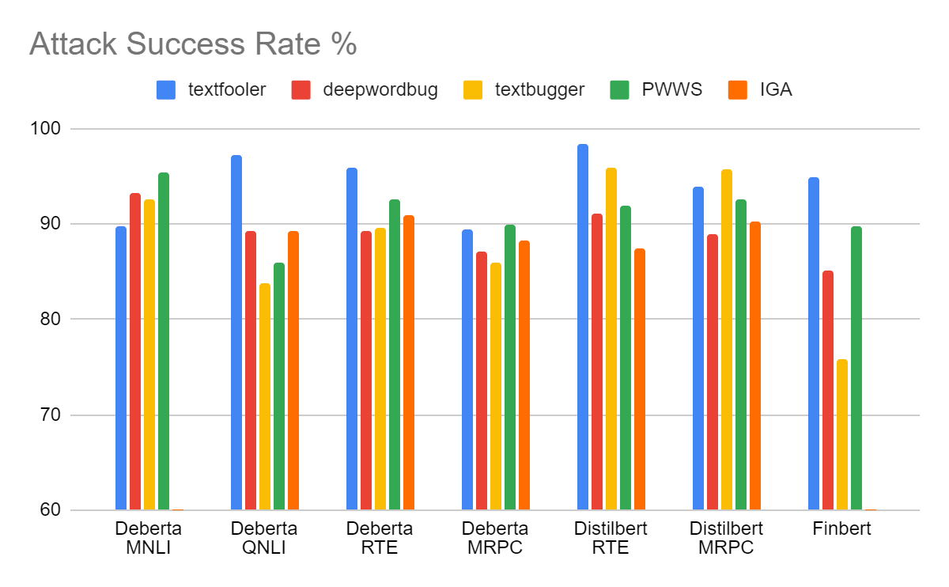
Comparision of attack Success Rates
All attacks seem to work pretty well: with the least attack success rate being 75% (textbugger, on finbert) and the best attack success rate being 98.37% (textfooler on distilbert - RTE).
Textfooler has the best attack success rate in 4/6 cases.
From the graph, we can infer that there is quite a bit of variation across datasets, models and attacks – implying that attack success rate is highly dependent on each of these factors.

Slide 18
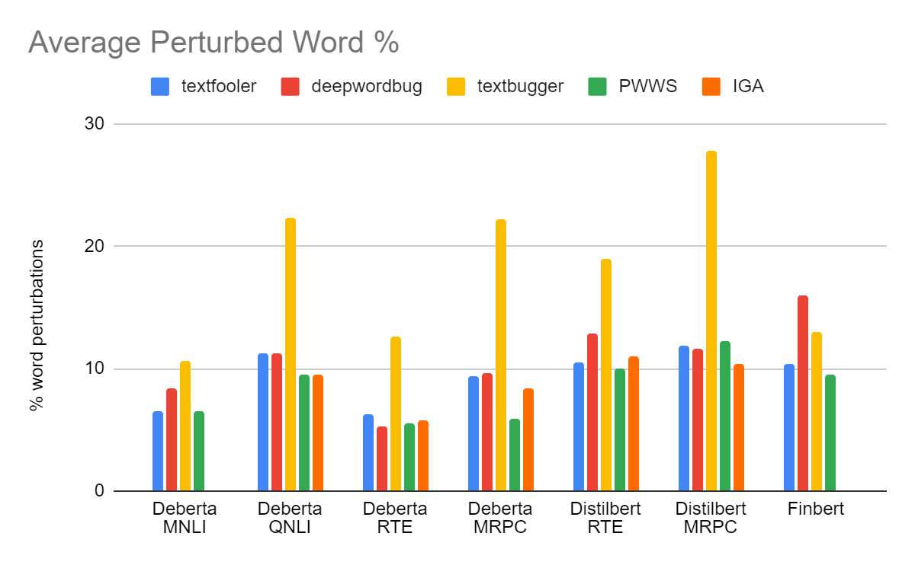
Comparision of Average Perturbations across attacks
Clearly, in almost all cases, textbugger causes the most perturbation to an input. Probably because it has the highest number of transformations (5) to choose from.
PWWS seems to cause the least perturbation in almost all cases. This makes sense since PWWS focuses on finding the one highly “salient” word and applying the transformation on that (word swap only) rather than perturbing the input multiple times.
PWWS, Textfooler and deepwordbug cause similar perturbation.

Slide 19
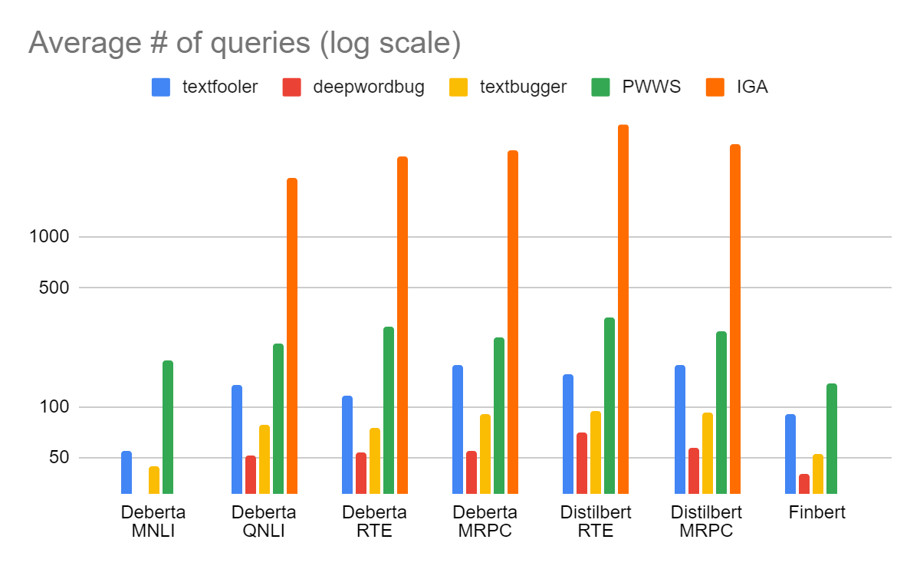
COMPARISION OF AVERAGE Number of Queries ACROSS ATTACKS
Improved genetic algorithm has the highest number of queries by far, which is clearly visible even on the log scale as shown. This is because the combination of two operations (mutate, crossover) across a huge population, leads to a large number of examples at every generation even for less successful transformations. Although textattack suggests that IGA is an improvement over GA, it was still quite slow.
Excluding IGA, PWWS has the highest average number of queries. This could be because since PWWS chooses to perturb the word with the highest effect on output classification, it might explore deeper along the search tree from this particular word for longer before switching to another word.

Slide 20
ATTACK EXAMPLE – DEBERTA on QNLI
Question: What came into force after the new constitution was herald?
Sentence: As of that day, the new constitution heralding the Second Republic came into force.
Ground Truth: Entailment
Model Output: Not Entailment
Attack | Failed Examples | Ground Truth
Textfooler | Question: What language did Tesla study while in school? Sentence: Tesla was the fourth of five children. | Not Entailment
Textbugger | Question: When was amnesty granted to those responsible for the massacre? Sentence: The exact number of fatalities throughout the country is not known. | Not Entailment
Deepwordbug | Question: When did the Warsaw Uprising begin? Sentence: the Polish government-in-exile in London gave orders to the underground Home Army (AK) to try to seize control of Warsaw from the Germans before the Red Army arrived. | Not Entailment
PWWS | Question: When did the Warsaw Uprising begin? Sentence: the Polish government-in-exile in London gave orders to the underground Home Army (AK) to try to seize control of Warsaw from the Germans before the Red Army arrived. | Not Entailment
IGA | Question: When did the Warsaw Uprising begin? Sentence: the Polish government-in-exile in London gave orders to the underground Home Army (AK) to try to seize control of Warsaw from the Germans before the Red Army arrived. | Not Entailment
Attack | Changes | Output after Attack
Textfooler | [[force]] => [[strengths]] | Not entailment
Textbugger | [[force]] => [[forϲe]] | Not entailment
Deepwordbug | [[force]] => [[forEce]] | Not entailment
PWWS | [[force]] => [[pressure]] | Not entailment
IGA | [[force]] => [[troop]] | Not entailment

Slide 21
ATTACK EXAMPLE – DEBERTA on MNLI
Premise: The census of 1931 served as an alarm signal for the Malay national consciousness.
Hypothesis: The 1931 Malay census was an alarm bell.
Ground Truth: Entailment
Model Output: Not Entailment
Attack | Failed Examples | Ground Truth
Textfooler | Premise: Fun for adults and children. Hypothesis: Fun for only children. | Not Entailment
Textbugger | Premise: Fun for adults and children. Hypothesis: Fun for only children. | Not Entailment
Deepwordbug | Premise: Fun for adults and children. Hypothesis: Fun for only children. | Not Entailment
PWWS | Premise: Fun for adults and children. Hypothesis: Fun for only children. | Not Entailment
Attack | Changes | Output after Attack
Textfooler | [[alarm]] => [[sirens]] | Not entailment
Textbugger | [[1931]] => [[19Ʒ1]] | Not entailment
Deepwordbug | [[1931]] => [[931]] | Not entailment
PWWS | [[force]] => [[pressure]] [[census]] => [[nosecount]] | Not entailment
IGA | [[alarm]] => [[cow]] | Not entailment

Slide 22
ATTACK EXAMPLE – fine-tuned-Finbert
Original text (dataset): Under this agreement Biohit becomes a focus supplier of pipettors and disposable pipettor tips to VWR customers throughout Europe.
Attack | Changes | num_queries
Textfooler | [[supplier]] => [[vendors]] | 27
Textbugger | [[supplier]] => [[purveyor]] | 31
Deepwordbug | [[supplier]] => [[suppleir]] | 19
PWWS | [[Under]] => [[below]] [[becomes]] => [[turn]] | 88

Slide 23
Defense 1 – adversarial training
Issue: Textattack’s adversarial trainer is not compatible with deBERTa/distilBERT.
Solution: Generate adversarial training data using the Textattack recipes (combine original and perturbed data), use Huggingface’s transformer trainer on our finetuned models.
Adversarial training hyperparameters (same as finetuning parameters)
learning_rate = 2e-5
per_device_train_batch_size = 8
weight_decay = 0.01
num_train_epochs = 2
Training dataset size: 2000 (1000 original, 1000 perturbed, from train split) for each dataset.

Slide 24
Adversarial training examples – DeBERTA on RTE
Sentence1: A number of the items that he auctioned off over the two day period have been seen on his reality TV show The Osbournes, which featured home life with Sharon, Ozzy and their two children. Amongst some of the higher-priced items were a carved walnut Victorian-style custom built pool table which raised $11,250, a painting from Edourad Drouot which fetched $10,500, a pair of Ozzy's famous round glasses which raised $5,250 and a dog bed given to Sharon by Elton John which sold for $2,375.
Sentence2: "The Osbournes" is the name of a reality show starring Ozzy Osbourne.
Ground Truth: Entailment
Model Output: Entailment
Attack | Changes | Output after Attack | Output after Defense
Textfooler | [[reality]] => [[truth]] | Not entailment | Entailment
Textbugger | [[Osbournes]] => [[Osbouⲅnes]] | Not entailment | Entailment
Deepwordbug | [[Osbournes]] => [[Osbournus]] | Not entailment | Entailment
PWWS | [[reality]] => [[realism]] [[show]] => [[record]] | Not entailment | Entailment

Slide 25
Adversarial training ExaMples–DeBERTA on MRPC
Sentence1:Unable to find a home for him , a judge told mental health authorities they needed to find supervised housing and treatment for DeVries somewhere in California.
Sentence2: The judge had told the state Department of Mental Health to find supervised housing and treatment for DeVries somewhere in California .
Ground Truth: Equivalent
Model Output: Equivalent
Sentence1: He made a point of saying during Tuesdays debate that the Confederate flag was a racist symbol.
Sentence2: Though Dean made a point of saying during the debate that the Confederate flag is a racist symbol .
Ground Truth: Equivalent
Model Output: Equivalent
Attack | Changes | Output after Attack | Output after Defense
Textfooler | [[find]] => [[arrive]] | Not equivalent | Not equivalent
Textbugger | [[find]] => [[fiոd]] | Not equivalent | Not equivalent
Deepwordbug | [[find]] => [[fknd]] [[home]] => [[hoem]] | Not equivalent | Not equivalent
PWWS | [[home]] => [[family]] | Not equivalent | Not equivalent
Attack | Changes | Output after Attack | Output after Defense
Textfooler | [[racist]] => [[sexist]] | Not equivalent | Equivalent
Textbugger | [[racist]] => [[racist | Not equivalent | Equivalent
Deepwordbug | [[racist]] => [[raicst]] | Not equivalent | Equivalent
PWWS | [[He]] => [[helium]] | Not equivalent | Equivalent

Slide 26
Adversarial training EXAMPLEs– DeBERTA on QNLI
Question: What came into force after the new constitution was herald?
Sentence: As of that day, the new constitution heralding the Second Republic came into force.
Ground Truth: Entailment
Model Output: Entailment
Attack | Changes | Output after Attack | Output after Defense
Textfooler | [[force]] => [[strengths]] | Not entailment | Entailment
Textbugger | [[force]] => [[forEce]] | Not entailment | Entailment
Deepwordbug | [[force]] => [[forϲe]] | Not entailment | Entailment
PWWS | [[force]] => [[pressure]] | Not entailment | Not entailment

Slide 27
Adversarial training EXAMPLes – DeBERTA on MNLI
Premise: The census of 1931 served as an alarm signal for the Malay national consciousness.
Hypothesis: The 1931 Malay census was an alarm bell.
Ground Truth: Entailment
Model Output: Entailment
Attack | Changes | Output after Attack | Output after Defense
Textfooler | [[alarm]] => [[sirens]] | Contradiction | Contradiction
Textbugger | [[1931]] => [[19Ʒ1]] | Contradiction | Entailment
Deepwordbug | [[1931]] => [[931]] | Contradiction | Entailment
PWWS | [[census]] => [[nosecount]] [[alarm]] => [[alarum]] | Contradiction | Contradiction

Slide 28
Adversarial training EXAMPLEs – DISTILBERT on RTE
Sentence1: New security steps taken by the Customs Service may not be enough to stop a terrorist from smuggling in nuclear weapons.
Sentence2: Steps are being taken to stop the smuggling of aliens.
Ground Truth: Not entailment
Model Output: Not entailment
Attack | Changes | Output after Attack | Output after Defense
Textfooler | [[be]] => [[got]] [[aliens]] => [[ufos]] | Entailment | Not entailment
Textbugger | [[may]] => [[ｍay]] | Entailment | Not entailment
Deepwordbug | [[may]] => [[mya]] | Entailment | Not entailment
PWWS | [[New]] => [[novel]] [[may]] => [[whitethorn]] [[aliens]] => [[alien]] | Entailment | Not entailment

Slide 29
Adversarial training examples – DISTILBERT MRPC
Sentence1: He said they lied on a sworn affidavit that requires them to list prior marriages.
Sentence2: Morgenthau said the women , all U.S. citizens , lied on a sworn affidavit that requires them to list prior marriages.
Ground Truth: Equivalent
Model Output: Equivalent
Attack | Changes | Output after Attack | Output after Defense
Textfooler | [[lied]] => [[lurks]] [[said]] => [[avowed]] | Not equivalent | Equivalent
Textbugger | [[said]] => [[saіd]] | Not equivalent | Equivalent
Deepwordbug | [[said]] => [[sad]] [[lied]] => [[liCed]] [[said]] => [[sEaid]] | Not equivalent | Equivalent
PWWS | [[said]] => [[enunciate]] [[S]] => [[randomness]]* | Not equivalent | Equivalent
*The letter “S” was changed to “randomness” via PWWS because PWWS uses “WordNet”, which lists “entropy, randomness” as synonyms for the letter “S”.
(source: http://wordnetweb.princeton.edu/perl/webwn?s=S&sub=Search+WordNet&o2=&o0=1&o8=1&o1=1&o7=&o5=&o9=&o6=&o3=&o4=&h= )

Slide 30
Adversarial training examples – FINE-TUNED-FINBERT
Original text: In January-September 2010 , Fiskars ' net profit went up by 14 % year-on-year to EUR 65.4 million and net sales to EUR 525.3 million from EUR 487.7 million .
Ground Truth: Positive
Model Output: Positive
Attack | Changes | Output after Attack | Output after Defense
Textfooler | [[In]] => [[Roundabout]] [[went]] => [[disappeared]] | Negative | Positive
Textbugger* | [[In]] => [[For]] [[January-September]] => [[Janսary-September]] [[2010]] => [[210]], [[profit]] => [[earnings]] [[went]] => [[wеntt]], [[14]] => [[l4]] [[EUR]] => [[EUROPEAN]], [[525]] => [[55]] [[million]] => [[billion]], [[million]] => [[m]] [[illion]] | Positive | Positive
Deepwordbug* | [[In]] => [[Ijn]], [[2010]] => [[2001]] [[Fiskars]] => [[Fiskras]], [[net]] => [[et]] [[went]] => [[wetn]], [[14]] => [[t14]], [[year-on-year]] => [[year-ony-ear]] [[EUR]] => [[EPUR]], [[million]] => [[millDion]] [[net]] => [[Dnet]]. [[525]] => [[55]], [[EUR]] => [[EUz]], [[million]] => [[illion]] | Positive | Positive
PWWS | [[went]] => [[die]] | Negative | Positive
* Failed attacks

Slide 31
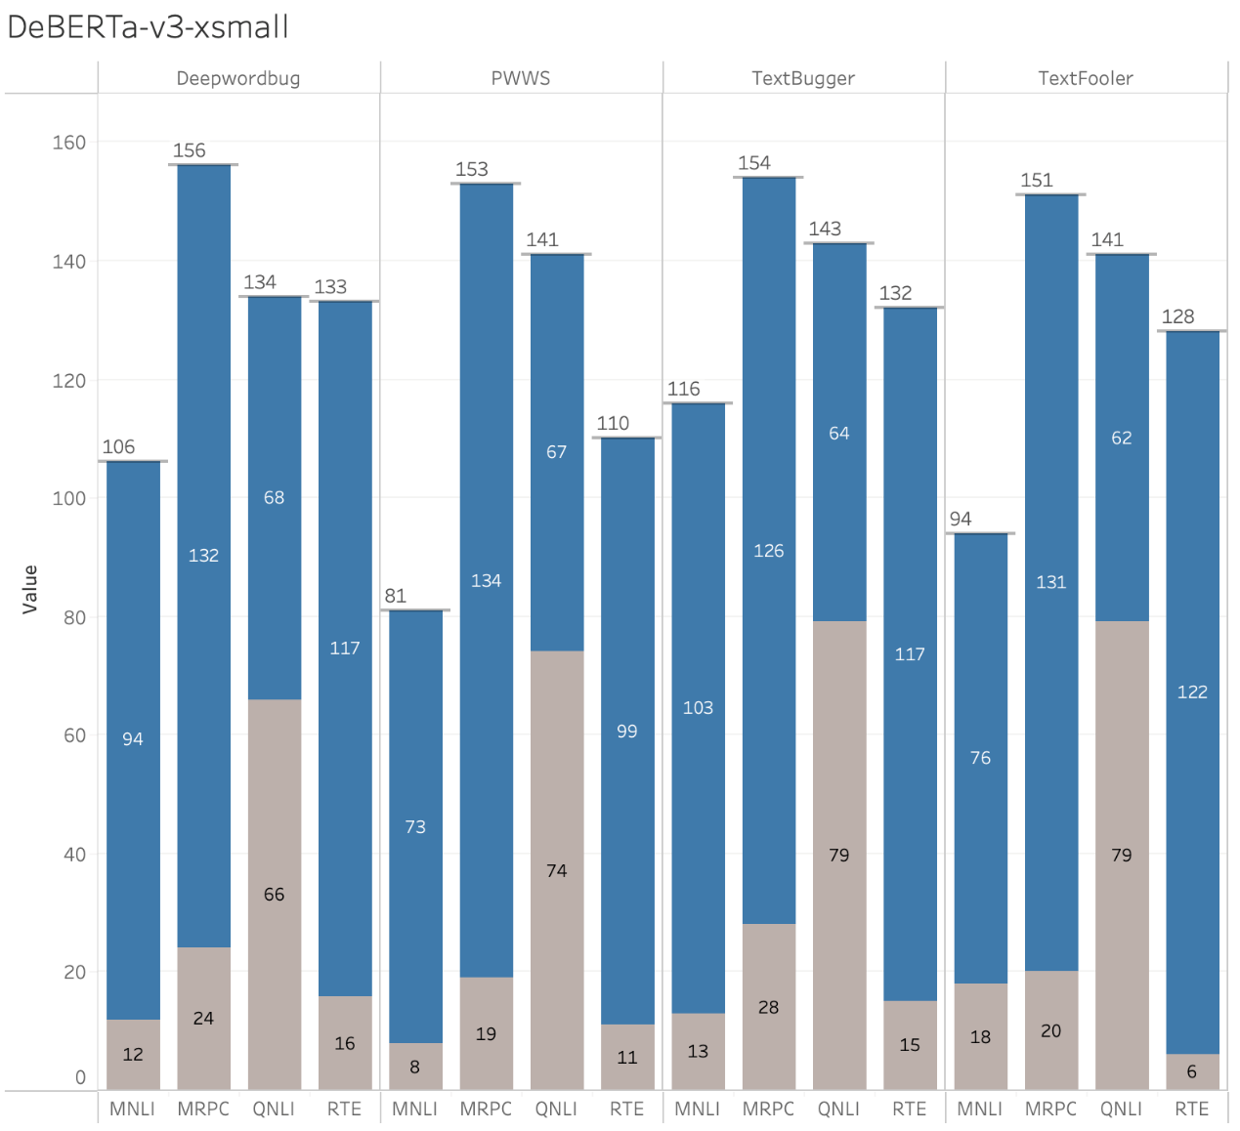
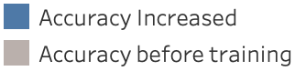
Adversarial training – DEBERTA RESULTS
The performance of the defense seems consistent across datasets rather than attacks, with defense behaving similarly across datasets.
The size of the dataset seems to play a big role in the effectiveness of the defense.
We used a fixed adversarial training data size of 1000 for all datasets. However, some datasets are smaller (RTE, MRPC) while some are much larger (MNLI). These 1000 data points may not be able to capture the intricacies of the larger datasets as well as they capture for a smaller dataset.
Speculation: if the adversarial training data size is scaled to be proportional to the actual training data available, we might be able to obtain a more uniform performance of the defense and reveal more insights. This would require a lot of compute power!
QNLI seems to consistently have a high base accuracy before adversarial training.
200 Validation Datapoints

Slide 32
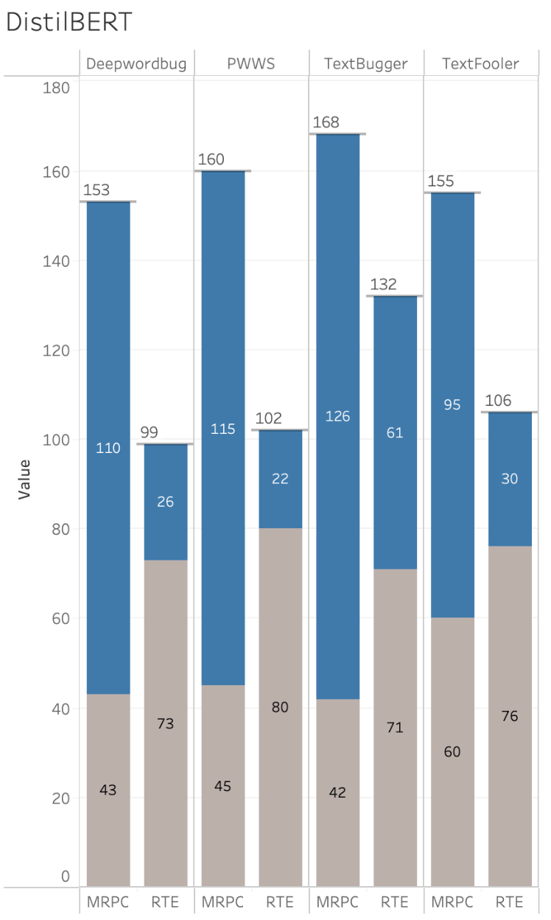
Adversarial Training results - Distilbert
We noticed a very similar trend from the defenses on DeBERTa.
Optuna’s hyperparameters were chosen over the validation split, and our current analysis is also done on the validation split. It is probable that overfitting occurred in the case of RTE (since it’s a smaller dataset than MRPC).
This could be the reason for a high accuracy on the attacked dataset and low increase in accuracy after adversarial training (showing a reluctance to learn from further).
200 Validation Datapoints

Slide 33
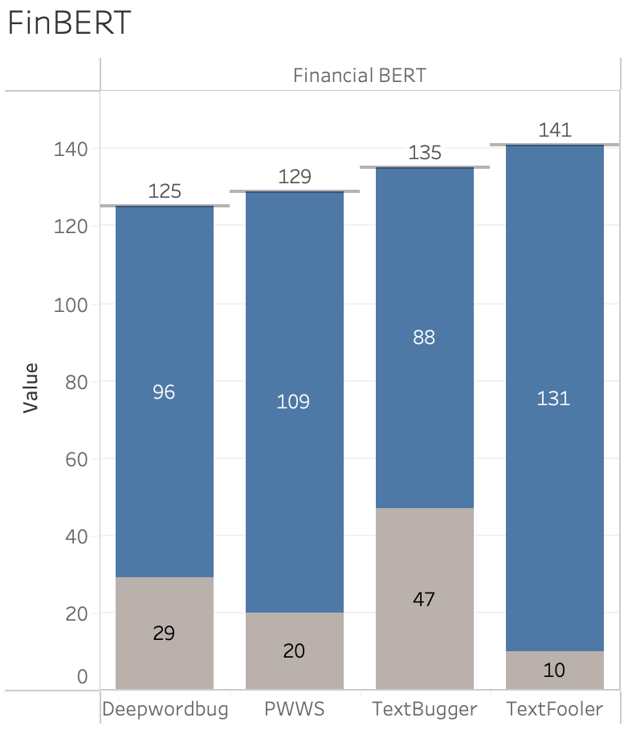
Adversarial Training results- fine-tuned-Finbert
The results of adversarial training are influenced by the internal logic of the attack method, given the same data scale.
The two character-based and letter-based attack methods, TextBugger and DeepWordBug, exhibit a broader range when selecting attack vocabulary (targets). However, the performance improvement obtained from pre-training and perturbed data is relatively small.
Adversarial training is more effective for methods with a narrower range of attack words. For instance, PWWS and TextFooler select the nearest k neighbors as targets for swapping words, and thus adversarial training shows a higher accuracy increase.
200 Validation Datapoints

Slide 34
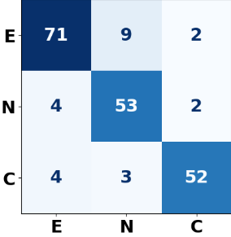
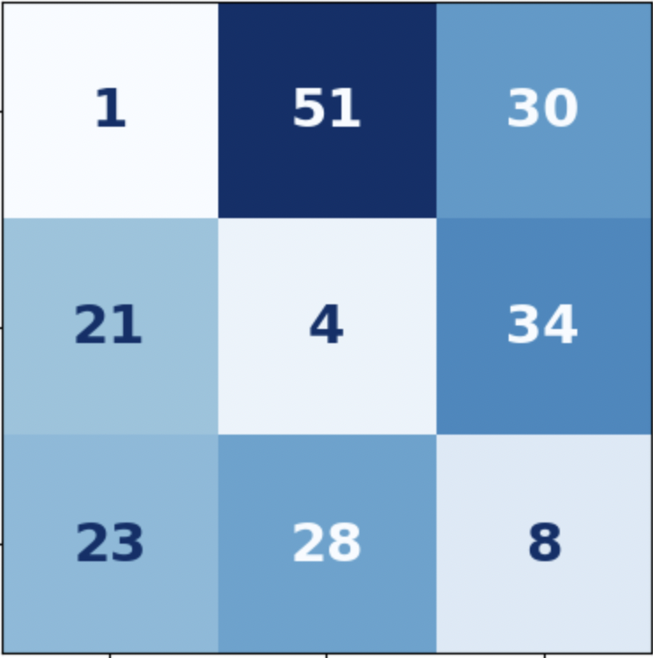
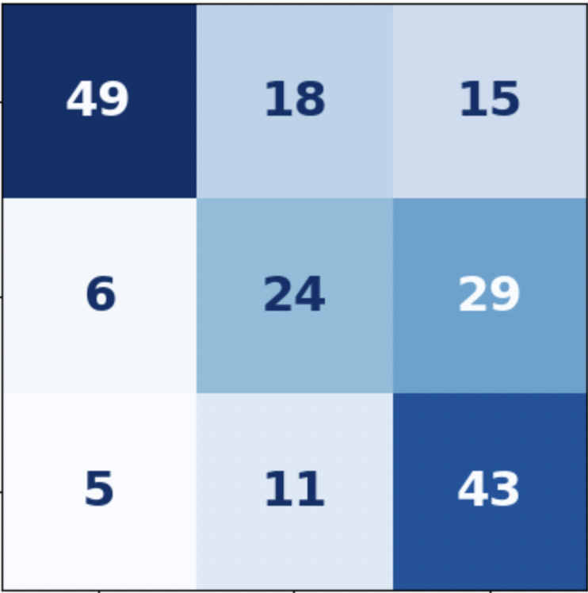
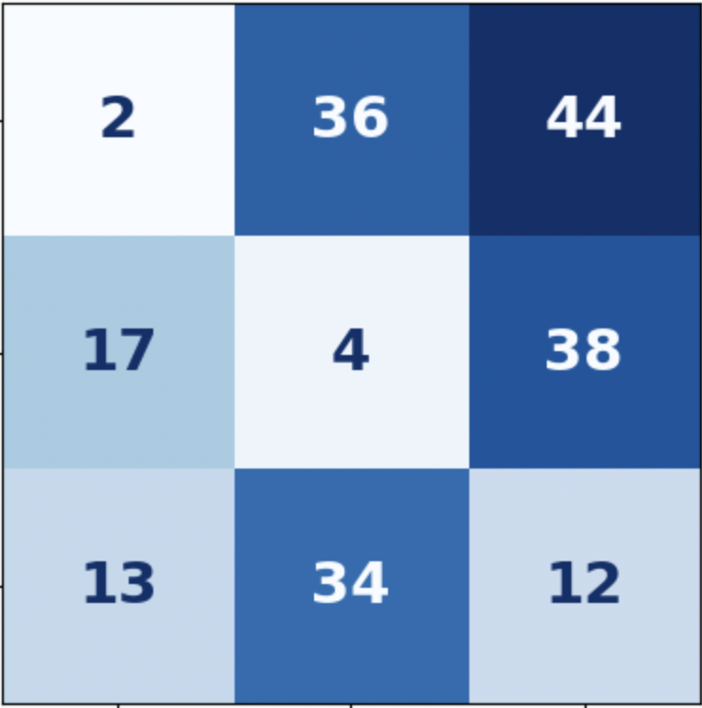
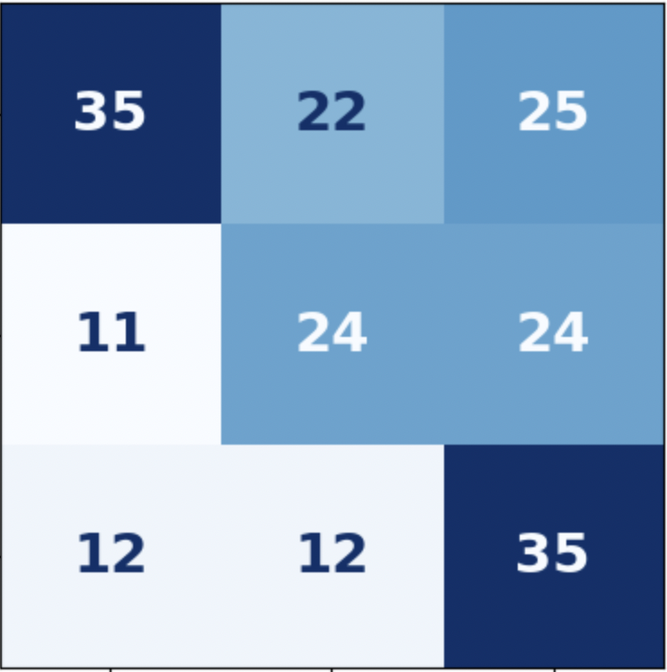
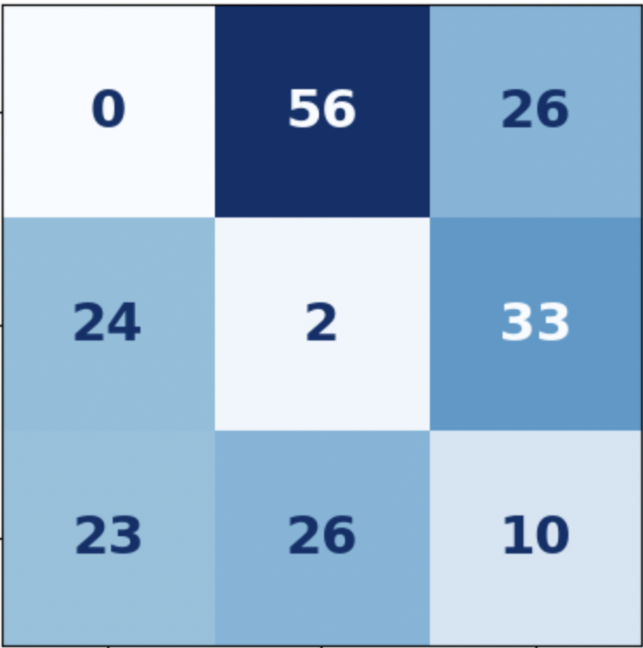
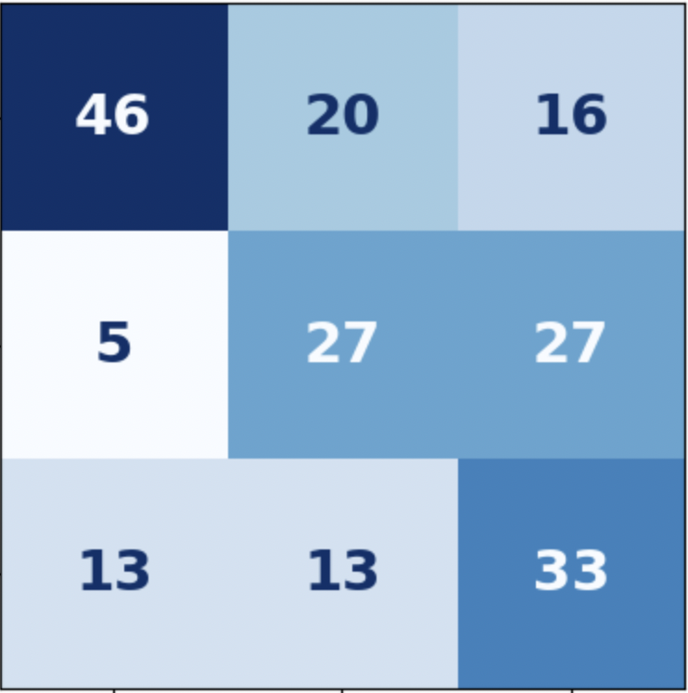
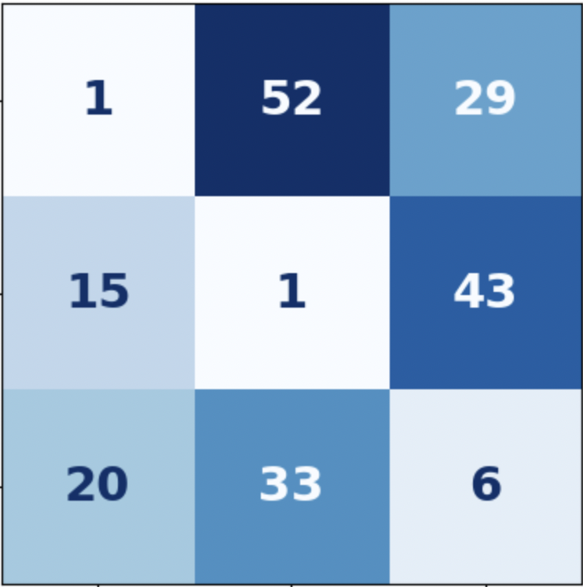
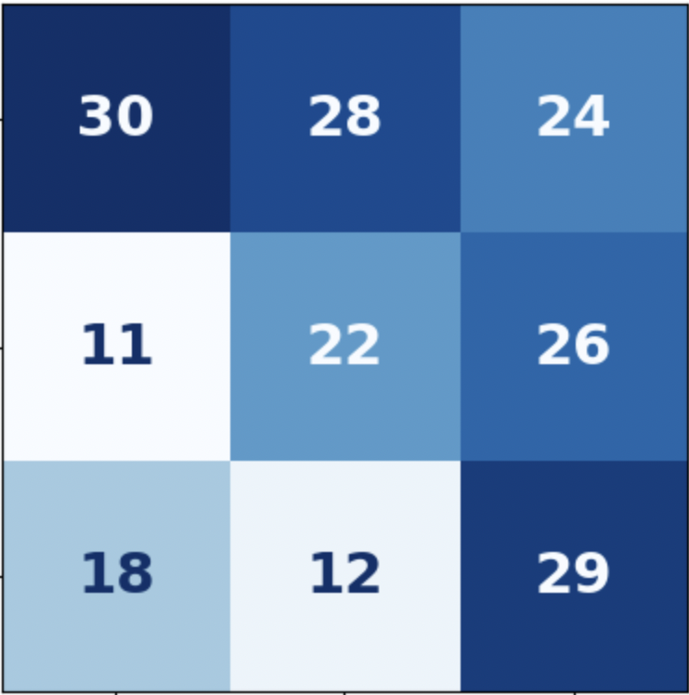
MNLI - Adversarial Training Label flip analysis
CM original | Attack Name | CM after attack | CM after defense
 | Textbugger
 | Deepwordbug
 | PWWS
Original confusion matrix is diagonally dominant, as expected for a good model.
After attack, the confusion matrix sees a lot of label flips.
The most notable observation would be the flipping of 44/200 observations from entailment to contradiction in the case of textfooler.
In the other 3 attacks, most flips seem to happen from entailment to neutral.
After defense (adversarial training), some of the diagonal dominance seems to have been restored, although not to the extent of the original confusion matrix.
The defense seems to perform poorly on PWWS while it performs the best on textbugger. For PWWS, it seems to flip towards a “neutral” label than towards the ground truth extremities.
Textfooler
True Label
Predicted Label

Slide 35
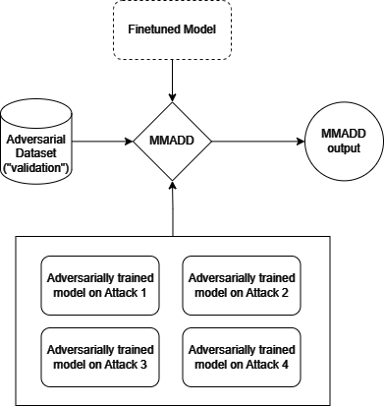
Defense 2 – Multi-model adversarial differential defense (MMADD)
Ensemble methods mitigate errors (and thus, attacks) across multiple sources. Our defense strategy relies on combining the output of the base model and the outputs of multiple models, which are adversarially trained on different attacks. The adversarially trained model output that shows the highest deviation from the base model output is taken as the final output of our model family.
Since it uses multiple adversarially trained models and uses a difference in class probability logits to arrive at a prediction, we call this a "Multi-Model Adversarial Differential Defense".

Slide 36
MMADD Explanation
Premise: From the corner of his eye he saw Jamus look over the broken [[mare => maria]].
Hypothesis: Jamus looked over the mare.
2.4385
-2.0311
-0.6953
Model 1
Model deviation: 2.5392
Model prediction: 0
2.1369
-2.1429
-0.2866
Max
Model Deviation
Model 2
Model deviation: 2.1305
Model prediction: 0
Input
Base model
-0.0536
-1.8063
1.8440
Model deviation: 0
Model prediction: 2
MMADD prediction: 0
Hyperparameter tuning
Threshold | Accuracy (%)
0 | 79.5
0.5 | 79.75
1 | 77.5
2 | 73.0
3 | 58.13
Model deviation: 1.7171
Model prediction: 0
Ground Truth: Entailment
Model Output: Contradiction
Ensemble Output: Entailment
Model 3
1.6740
-1.9973
-0.1269
Model deviation: 1.8817
Model prediction: 0
Model 4
1.6740
-1.9973
-0.1269
Threshold = 0.5
Model family (base model +
Adv. trained models)
Tensor of logit probabilities

Slide 37
Adversarial training vs MMADD
Premise: The census of 1931 served as an alarm signal for the Malay national consciousness.
Hypothesis: The 1931 Malay census was an alarm bell.
Ground Truth: Entailment, Model Output: Contradiction, MMADD Output: Entailment
Attack | Changes | Output after Attack | Adversarial Defense | MMADD Defense
Textfooler | [[alarm]] => [[sirens]] | Contradiction | Contradiction | Entailment
Textbugger | [[1931]] => [[19Ʒ1]] | Contradiction | Entailment | Entailment
Deepwordbug | [[1931]] => [[931]] | Contradiction | Entailment | Entailment
PWWS | [[census]] => [[nosecount]] [[alarm]] => [[alarum]] | Contradiction | Contradiction | Entailment
There is an overlap between the different transformations used in the 4 attacks (for example, all three of DeepWordBug, TextBugger and Textfooler involve character level perturbations). The adversarial models are able to collectively pick up nuances that enable MMADD to perform better than any one adversarial model.

Slide 38
MMADD examples - Successful
Premise: From the corner of his eye he saw Jamus look over the broken [[mare => maria]].
Hypothesis: Jamus looked over the mare.
Ground Truth: Entailment ,Model Output: Contradiction ,Ensemble Output: Entailment
MNLI
Sentence1: Pibul Songgram was the pro-Japanese military [[dictator => potentate]] of Thailand during World War 2.
Sentence2: Pibul was the dictator of Thailand.
Ground Truth: Entailment ,Model Output: Not Entailment ,Ensemble Output: Entailment
RTE
Sentence1: [[He => Helium]] [[added => supplied]] that those " are not solely American principles , nor are they exclusively Western . “
Sentence2: " These are not solely American principles nor are they exclusively Western , " Rumsfeld said .
Ground Truth: Equivalent ,Model Output: Not Equivalent ,Ensemble Output: Equivalent
MRPC
Question: What is the [[name => key]] for a response of the immune system that damages the body's native tissues?
Sentence: Hypersensitivity is an immune response that damages the body's own tissues
Ground Truth: Entailment ,Model Output: Not Entailment ,Ensemble Output: Entailment
QNLI

Slide 39
MMADD examples - failure
Premise: [[Sorry => drab]] but that's how it is.
Hypothesis: This is how things are and there are no apologies about it.
Ground Truth: Contradiction, Model Output: Neutral, Ensemble Output: Neutral
MNLI
Sentence1: Dana Reeve, the widow of the actor Christopher Reeve, has [[died => perish]] of lung [[cancer => Cancer]] at age 44, according to the Christopher Reeve Foundation.
Sentence2: Christopher Reeve had an accident.
Ground Truth: Not Entailment, Model Output: Entailment, Ensemble Output: Entailment
RTE
MRPC
Sentence1: Broomhead was assigned to 2nd Squadron , 3rd Armor Cavalry Regiment , based at [[Fort => garrison]] Carson.
Sentence2: Broomhead , 34 , was assigned to the 2nd Squadron , 3rd Armored Cavalry Regiment
Ground Truth: Equivalent, Model Output: Not Equivalent, Ensemble Output: Not Equivalent
Question: What is the [[first => foremost]] major city in the stream of the Rhine?
Sentence: The most important tributaries in this area are the Ill below of Strasbourg, the Neckar in Mannheim and the Main across from Mainz
Ground Truth: Not Entailment, Model Output: Entailment, Ensemble Output: Entailment
QNLI

Slide 40
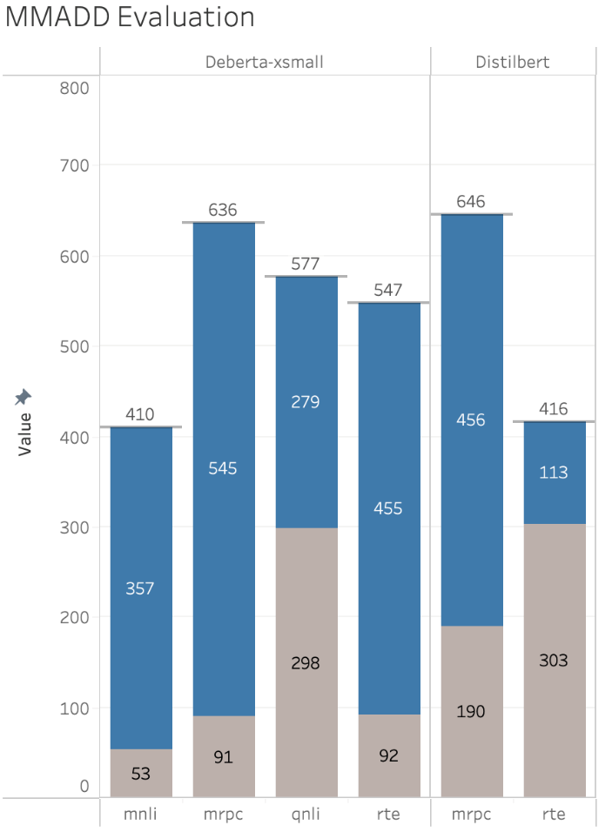
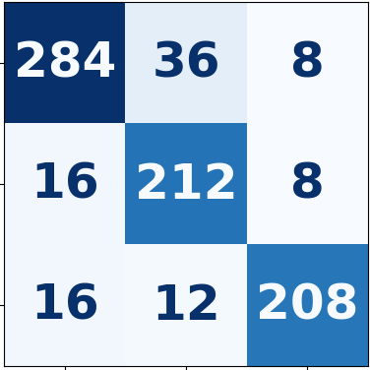
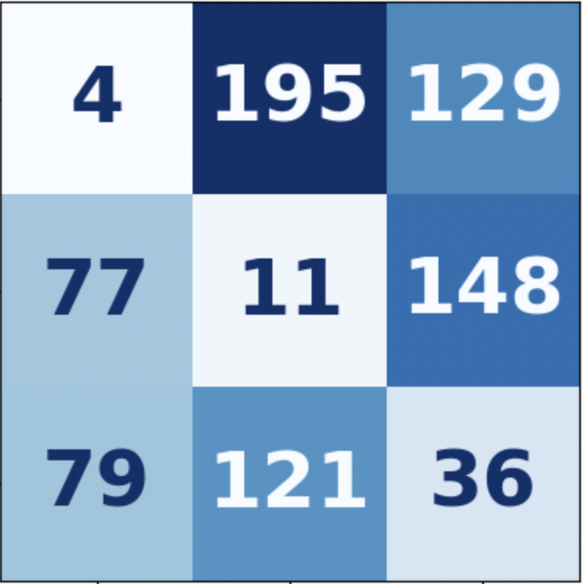
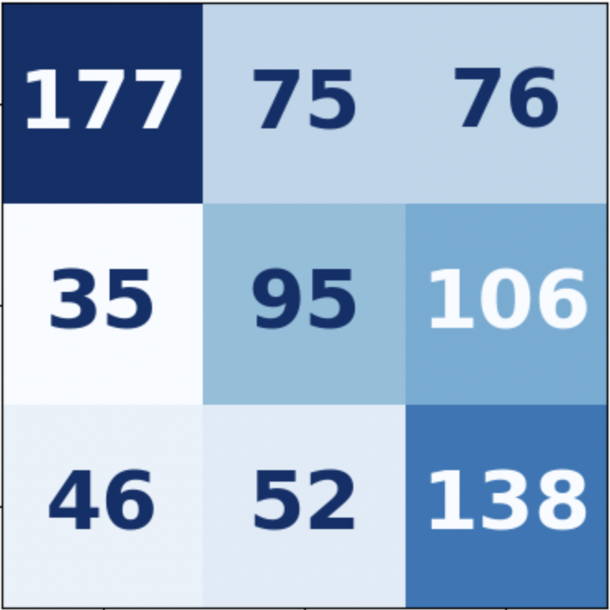
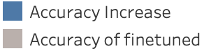
MMADD – analysis
Overall Accuracy and Performance Analysis
MNLI label-flip analysis
As seen with Adversarial training, QNLI has a higher base accuracy.
On RTE, Distilbert doesn't show a higher increase in accuracy as compared to Deberta – this shows that the adversarially trained Distilbert models aren't performing as well. This could be attributed to the limited scope of text corpus that distilbert was trained on.
MNLI has a lower overall accuracy and lower overall increase in accuracy. This could be attributed to MNLI having 3 labels as opposed to the other datasets having 2 labels.
Original
Attacked
MMADD
Original confusion matrix is diagonally dominant, as expected for a good model.
The various attacks performed flip the model entailments as expected. A lot of these flips are towards "neutral", and a highly visible change is the increase in "entailment => neutral" predictions
Another notable change is the number of flips from "entailment => contradiction", from 8 to 129 flips.
The MMADD output brings the confusion matrix much closer to the initial pre-attack confusion matrix.
800 Validation Datapoints

Slide 41
Project Limitations
Restricted to smaller datasets for DistilBERT due to computational constraints; Colab's limitations led to crashes with larger data.
Incomplete exploration of IGA attacks across datasets – as shown by the average number of queries, it is a computationally expensive attack. Moreover, the textattack implementation is unreliably buggy for this specific attack. The framework takes a barebones approach and prioritizes a generalized framework which widens the scope of use but makes the resolution of attack-specific bugs difficult.
Incompatibility with textattack trainers for adversarial training – currently, the trainers support only a handful of model types for adversarial training on an attack recipe. We circumvented this limitation by preparing adversarial datasets for use with the Huggingface Transformers library.
Opted for smaller BERT variants over BERT base models to accommodate resource limitations affecting the implementation of adversarial attacks.

Slide 42
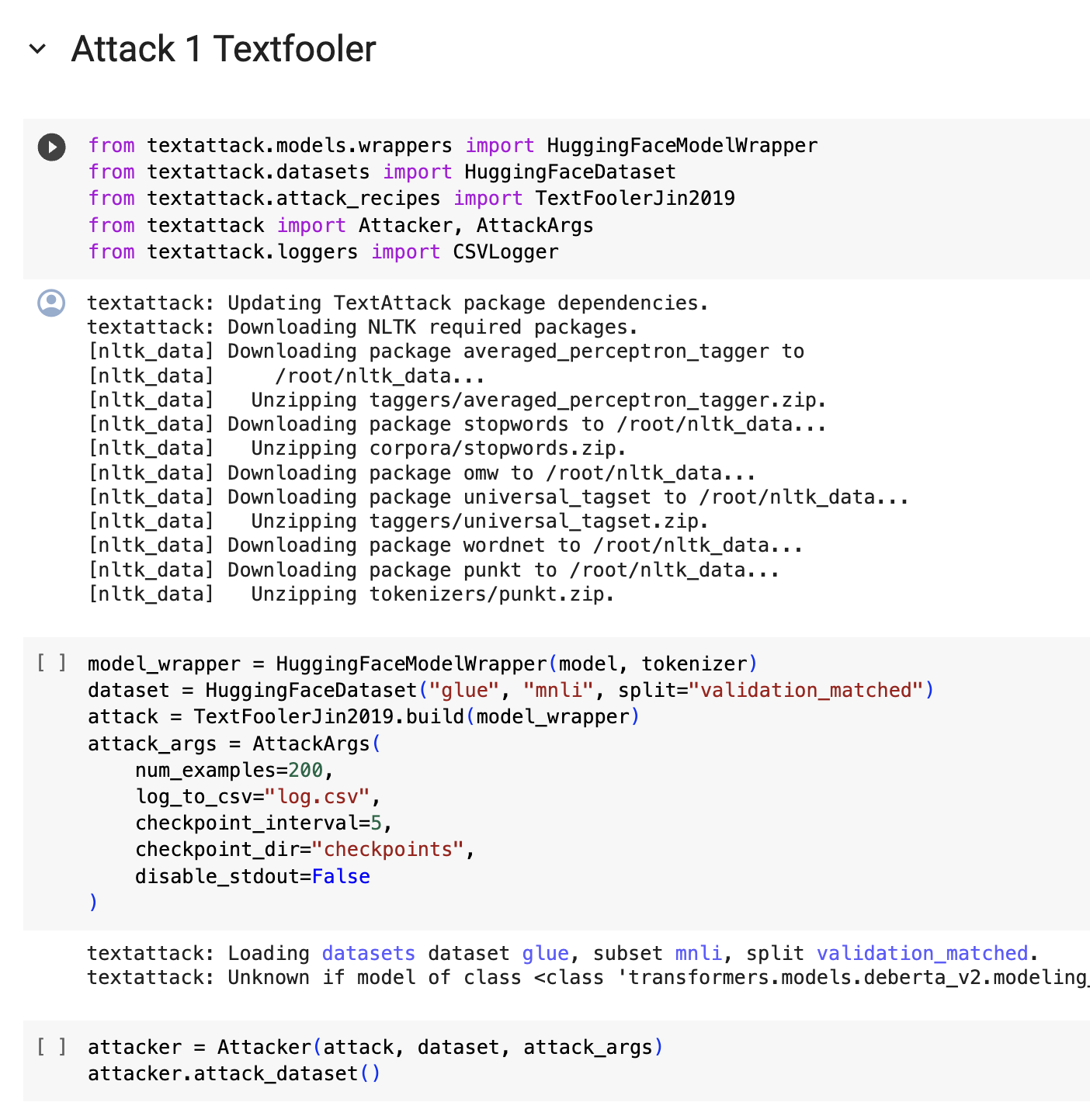
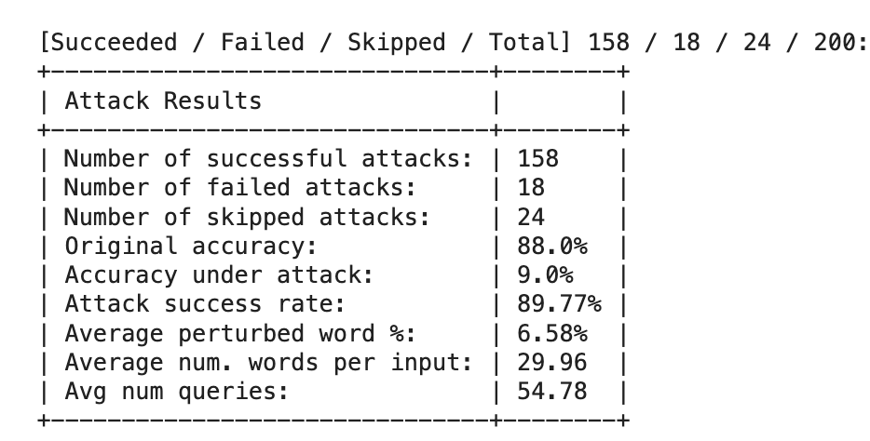
Code Snippet - Example of an attack
Output

Slide 43
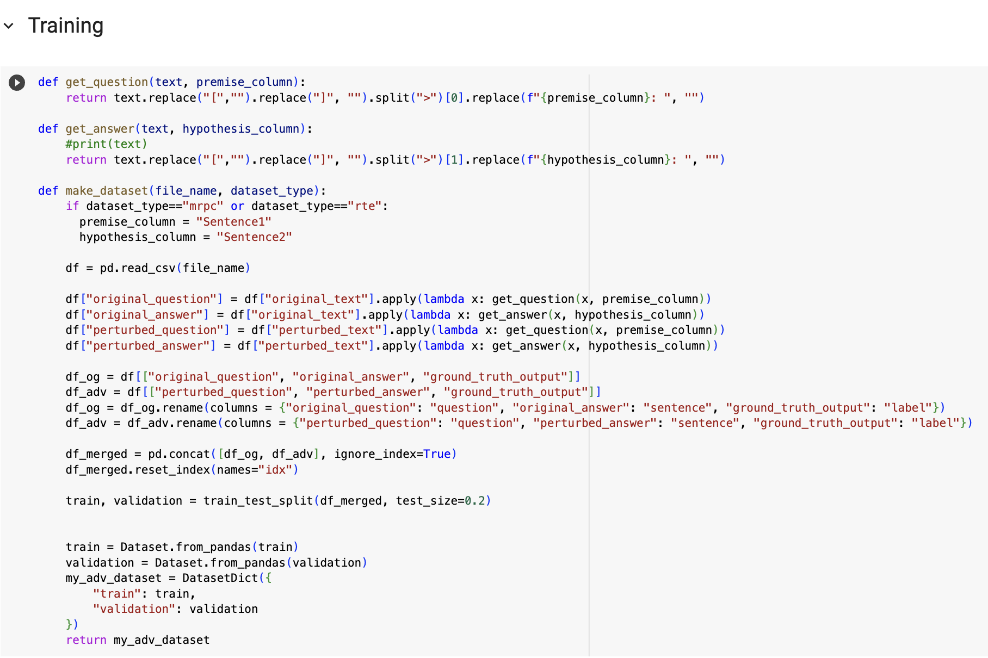
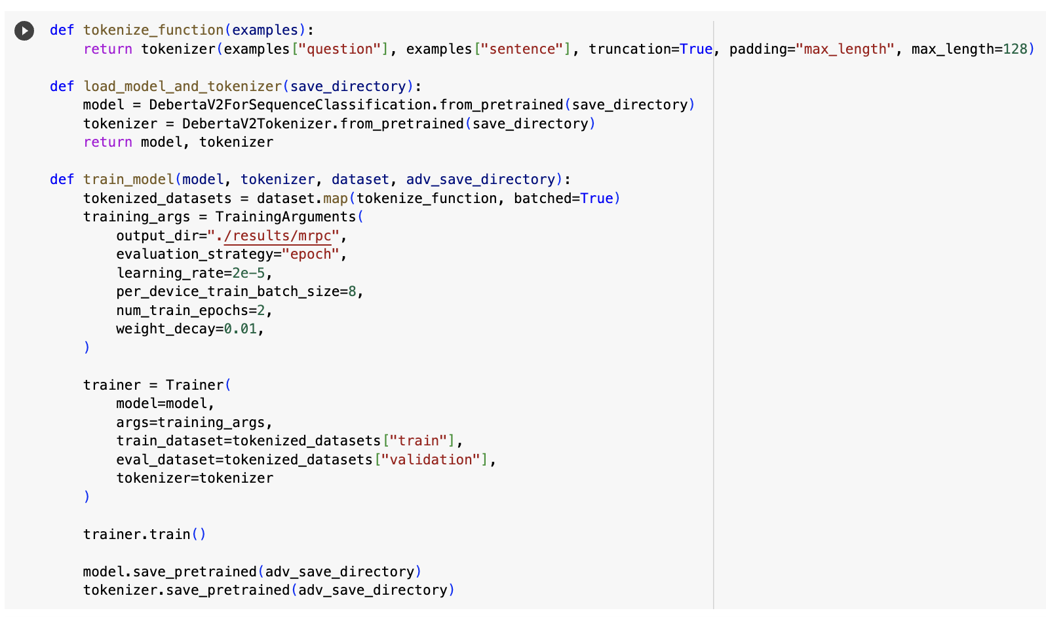
Code Snippet - EXAMPLE of Adversarial training

Slide 44
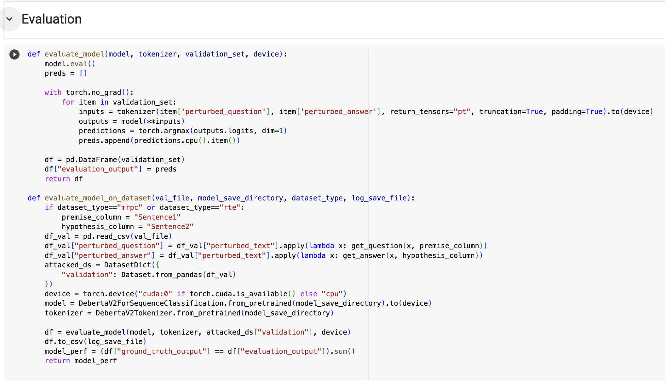
Code Snippet – Example for EVALUATION

Slide 45
Conclusions
TextBugger claims to work better than deepwordbug and shows results accordingly. Our experiments show that deepwordbug and Textbugger have similar or lesser attack success rates.
The adversarial attacks majorly do not pay attention to the context change for the word through perturbations, as shown in PWWS where swapping the letter “S” for “randomness” is counted as a valid perturbation but it results in a contextually unrelated and incorrect statement.
With no examples to account for context aware perturbations, the models failed on such perturbations (as shown in MMADD failure cases, where making meaningful perturbations successfully evaded the defense). Context aware adversarial training would help defend against context aware attacks.
Approaches such as Mixture-of-Experts (which is quite similar to MMADD) could perform well on adversarial attacks over a wide range.

Slide 46
References
Textattack : https://textattack.readthedocs.io/en/master/index.html
DeBERTa-v3-xsmall: https://huggingface.co/microsoft/deberta-v3-xsmall
DistilBERT-base-uncased: https://huggingface.co/distilbert-base-uncased
Glue datasets: https://huggingface.co/datasets/glue
Optuna: https://github.com/optuna/optuna
Fine-tuned-FinBert: https://huggingface.co/mstafam/fine-tuned-bert-financial-sentiment-analysis
Finance auditor sentiment datasets: https://huggingface.co/datasets/FinanceInc/auditor_sentiment

